Slide 1

Bangladesh University of Engineering and Technology
ME 174 (CSE):
MECHANICAL ENGINEERING DRAWING AND CAD
Course Teachers:
Shahriar Alam, Assistant Professor
Taslima Hossain Sanjana, Adj. Lecturer
Sakil Hossen, Drafting Instructor
Department of Mechanical Engineering, BUET

Slide 2
Course Outcomes
At the end of the course, the students will be able to:
1.Understand the theory of projection. To improve the visualization skills.
2. Know and understand the conventions and the methods of engineering drawing.
3. Identify the orthographic views of a given 3D objects precisely.
4. Predict the isometric view of an object from the given orthographic views correctly.
5. Sketch sectional views of an object if needed.
6. Sketch orthographic and sectional views using AutoCAD

Slide 3
Reference Books
The most common book to follow:
Mechanical Engineering Drawing
-Dr. Amalesh Chandra Mandal
-Dr. Md. Quamrul Islam
You may also look for resources online.

Slide 4
Lecture Plan
Lecture 1: Introduction: Basic Drawing Practice
Lecture 2: Orthogonal views of simple block with circular holes
Lecture 3: Orthogonal views with fillets and rounds
Lecture 4: Sectional views
Lecture 5: Isometric views
Lecture 6: Isometric views with circular holes
Lecture 7 onwards: Mechanical Drawing using CAD

Slide 5
Mark Distribution
•Total mark will be distributed tentatively as follows:
Attendance 10%
Class Performance 30%
Viva 10%
Midterm Quiz 25%
Final Quiz (CAD) ___25%
Total 100%
Students are given a task to draw in every class and it is evaluated and returned back in the next class. Preserve the drawing sheets as you will have to submit them before quiz. The best six marks from all the class-works will be counted.
The viva or oral exam will be taken during any of the classes. The date will be announced later.

Slide 6
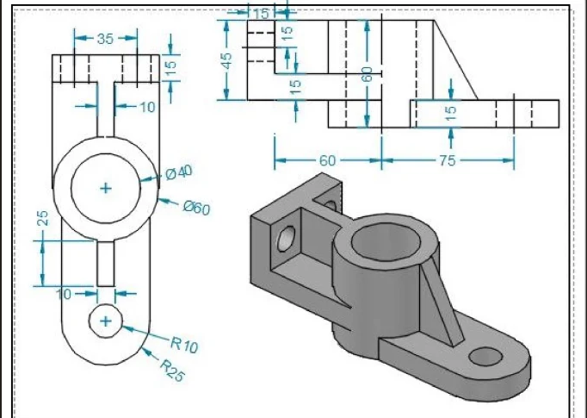
Application
Try to describe the object above to another person who has not seen it and see if he/she understands or not. You can easily realize that words are inadequate to describe the object completely.
To build or manufacture any object, its complete information has to be provided to the manufacturer.
Mechanical drawing of an object provides complete information of it.

Slide 7
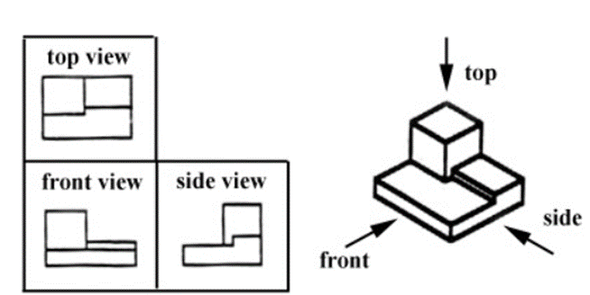
Principal Views
The views from different angles are different.
Front View
Top View
Right Side View
Left Side View
Rear View
Bottom View

Slide 8
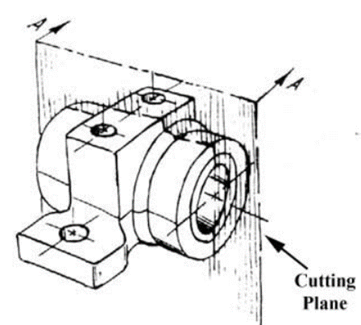
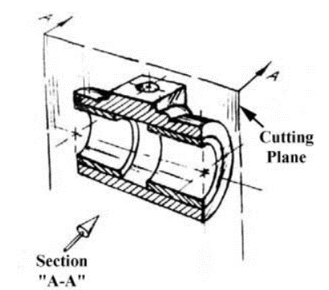
Sectional View

Slide 9
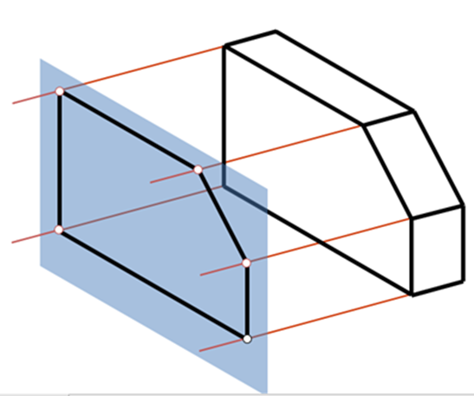
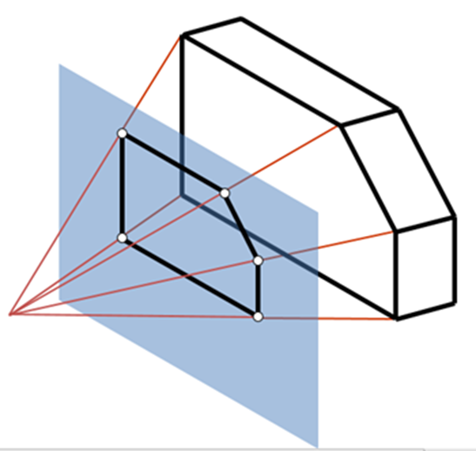
Parallel Projection and Perspective Projection
Parallel Projection:
1.The lines of sight are parallel
2. Parallel lines remain parallel
3. Good for exact measurement
4. Less realistic looking.
Perspective Projection:
1.The lines of sight converge to one (or more) point(s).
2. Size varies inversely with distance.
So, looks more realistic.
3. Parallel lines do not remain parallel.

Slide 10
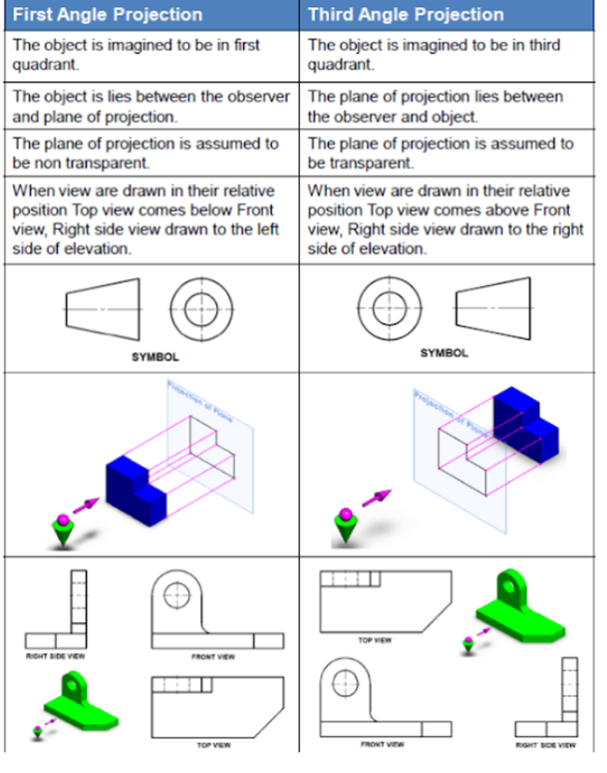
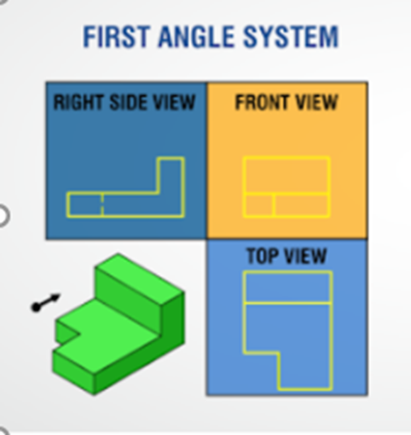
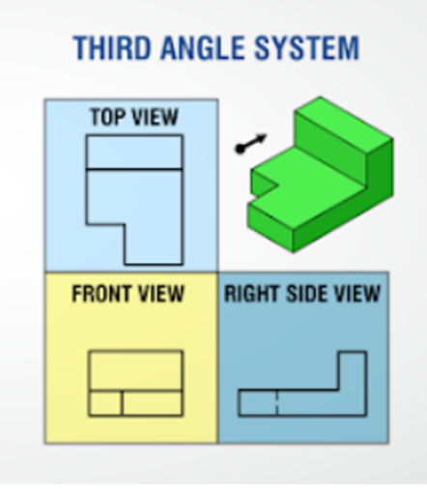
First Angle vs Third Angle Projection

Slide 11
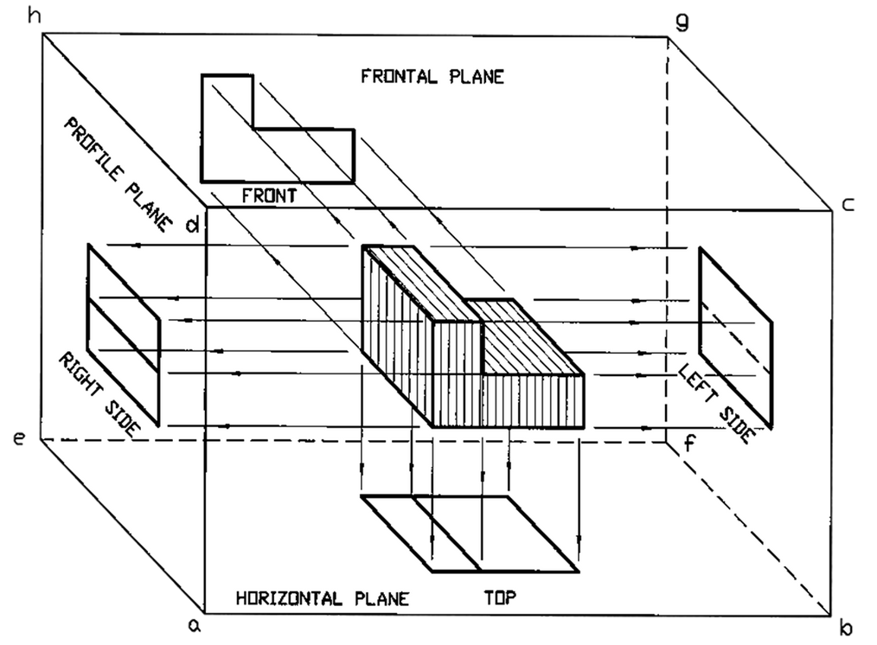
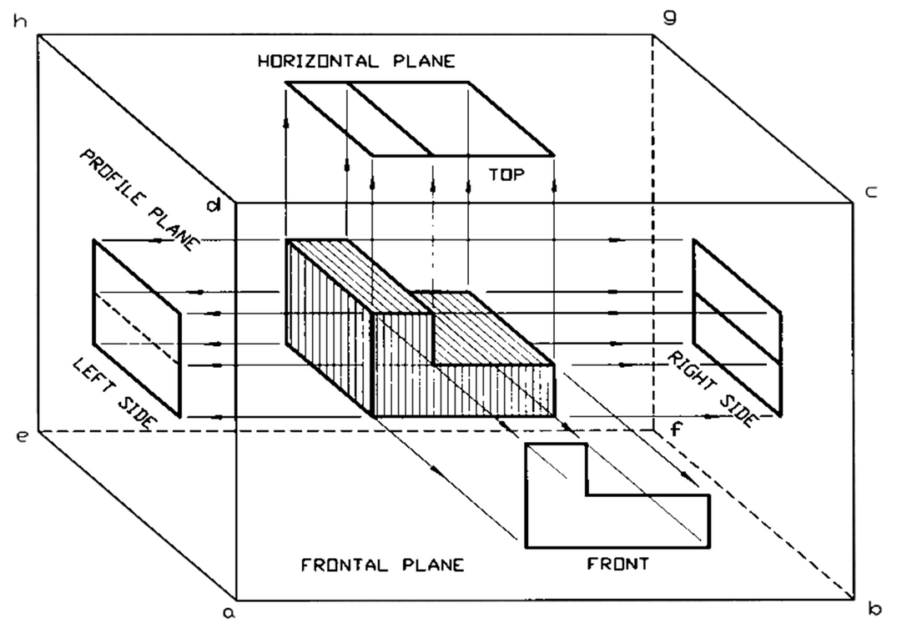
First Angle Projection
Third Angle Projection
The object is placed between the observer and the plane of projection. i.e. between you and the drawing plane. Each face of the box contains the view that satisfies the above condition.
The plane of projection i.e. the art paper is placed between the observer and the object. Each plane of the box contains the view that satisfies the above condition.

Slide 12
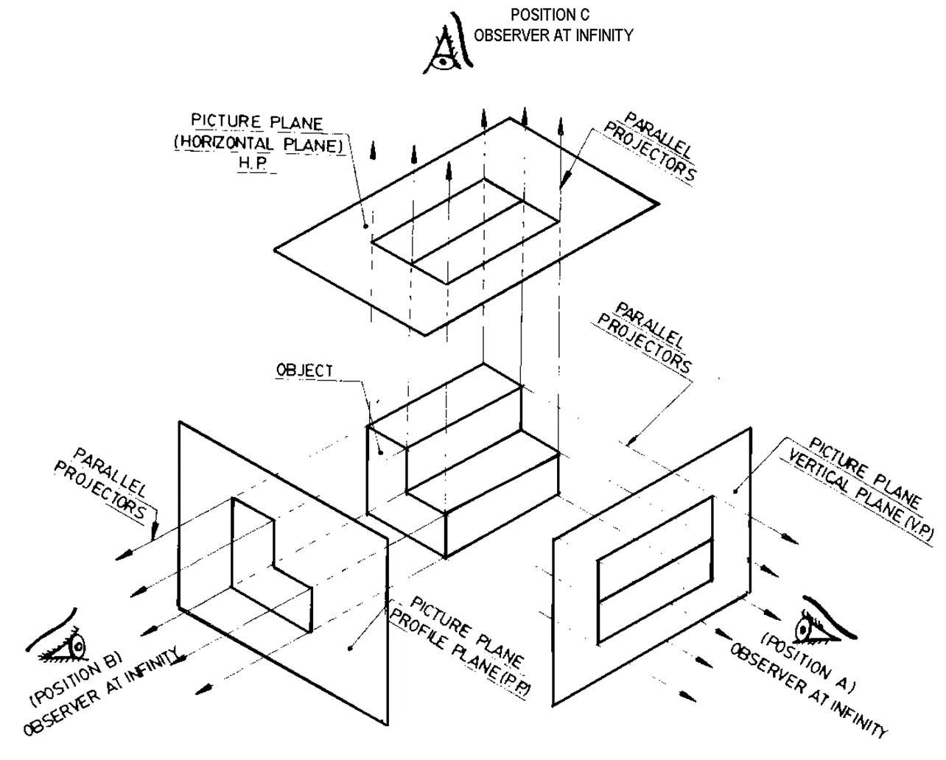
Basics of Orthographic Views

Slide 13
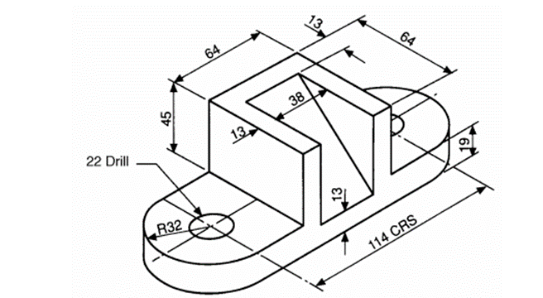
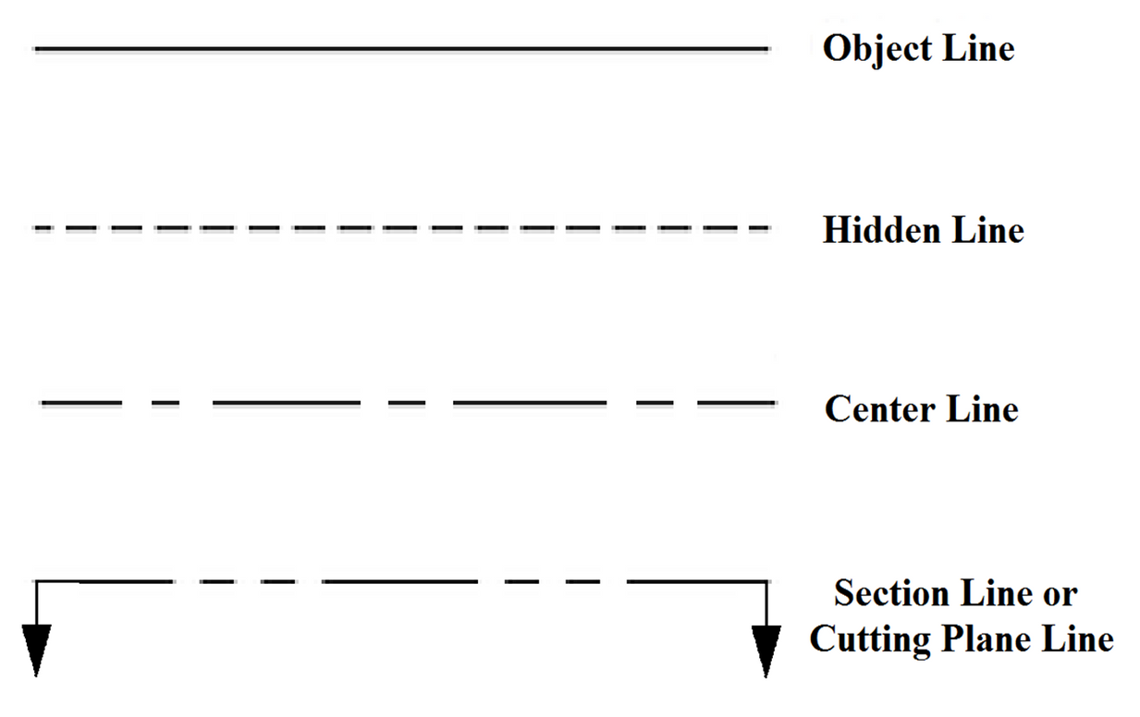


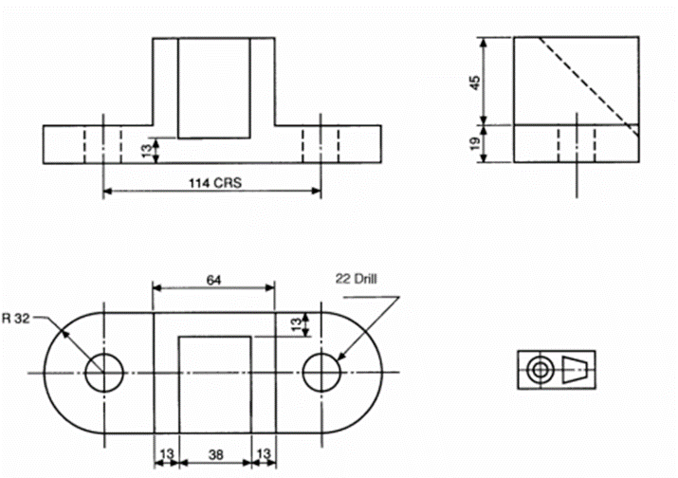
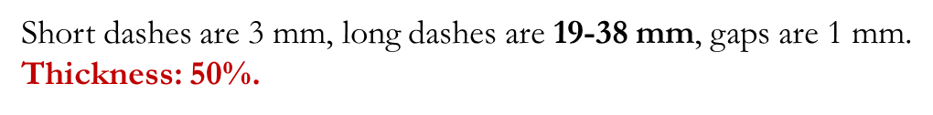

Lines
Pictorial View
Apart from these lines, there are hatchet, extension and dimension lines with 25% thickness.
Orthographic View (3rd Angle Projection)

Slide 14
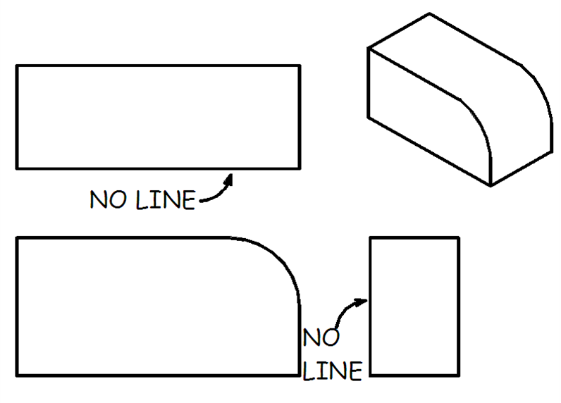
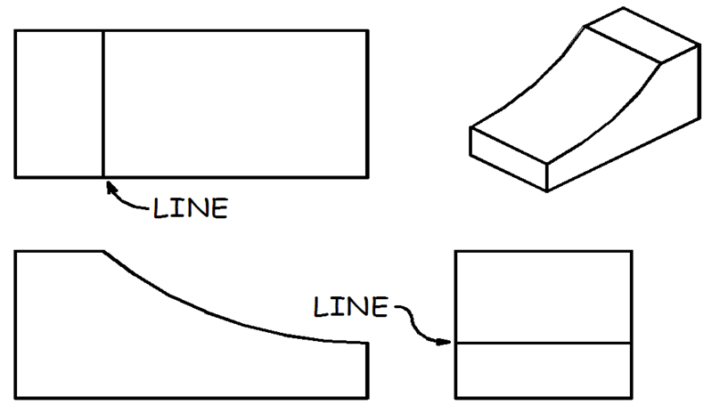
Sharp Edge vs Curved Edge
If a curved surface is tangent to a plane surface, no edge is formed. So, there will be no line.
But if a curved surface intersects with a plane surface, an edge is formed.
So, there should be a line in the views.

Slide 15
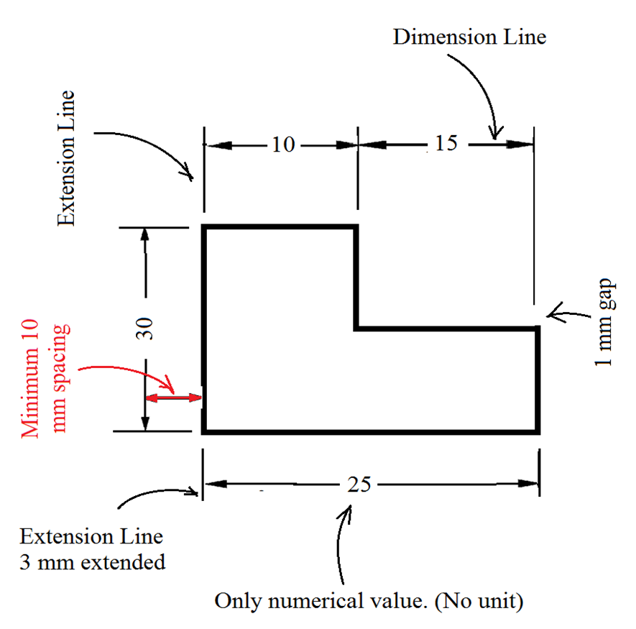
Dimensioning Guidelines
1.Dimension and extension lines must be either horizontal or vertical.
2.No dimension/extension line can cross over another dimension/extension line.
3.There must be one arrowhead at each end of dimension line.
4.The thickness of both extension and dimension line is 25%.
5.No dimensioning is allowed inside the object.

Slide 16
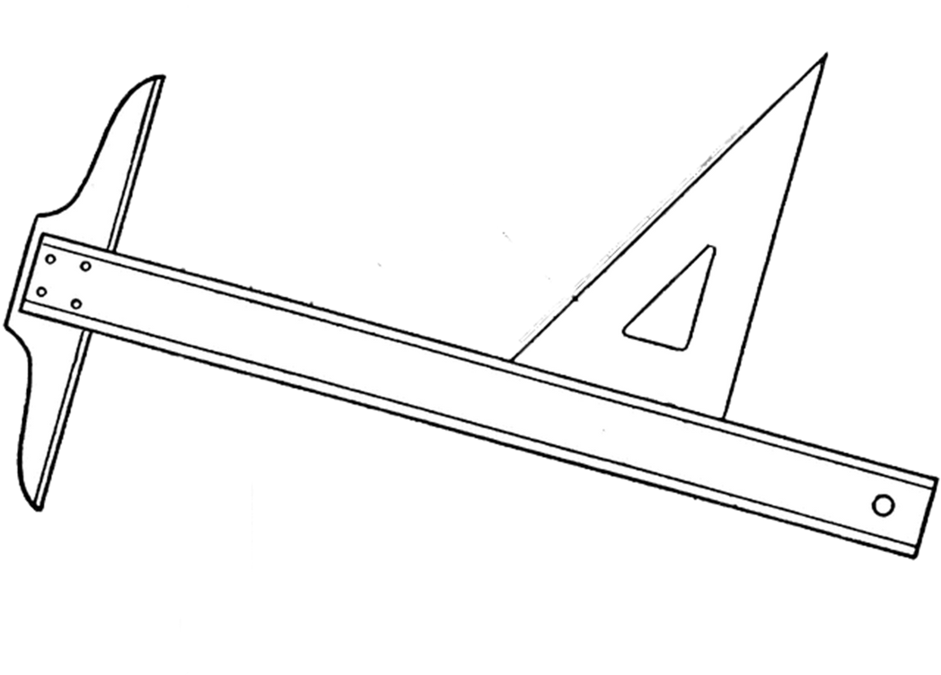
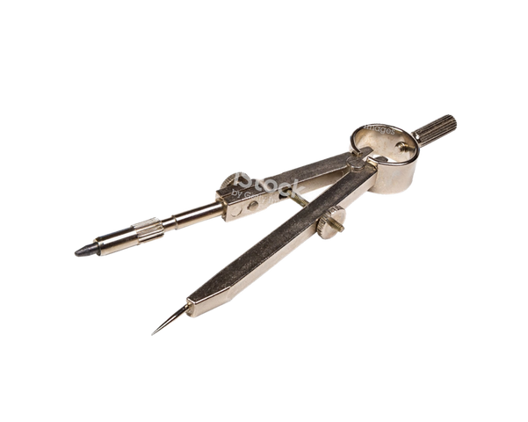
Instruments
Drawing Sheet/Paper (724mm x 585mm)
Pencil (2B), eraser and sharpener
T-square/T-scale (1 m)
Set-squares/triangles (large)
30 degrees
45 degrees
Divider
Drafting tape/Masking tape

Slide 17
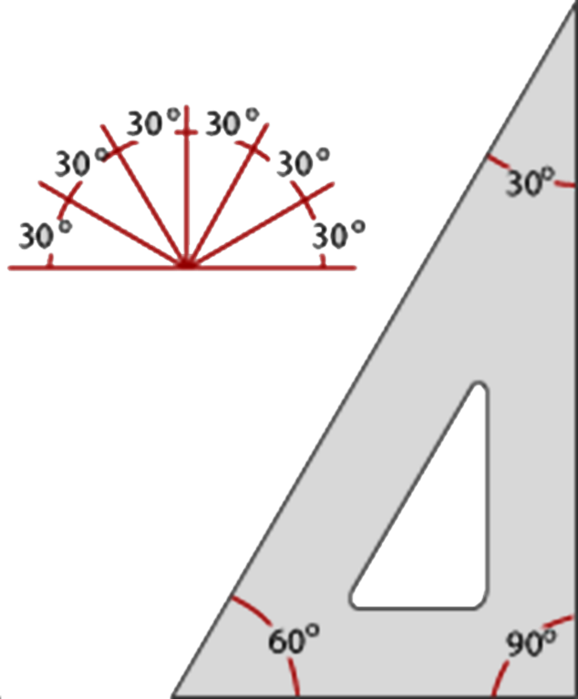
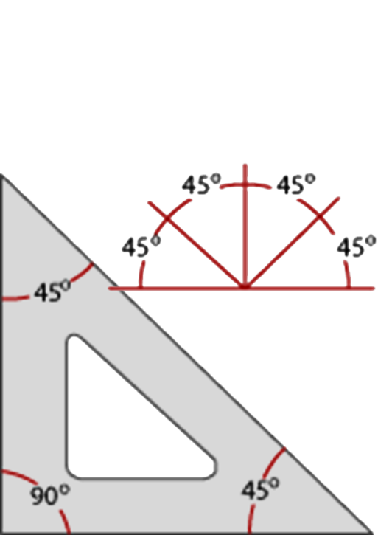
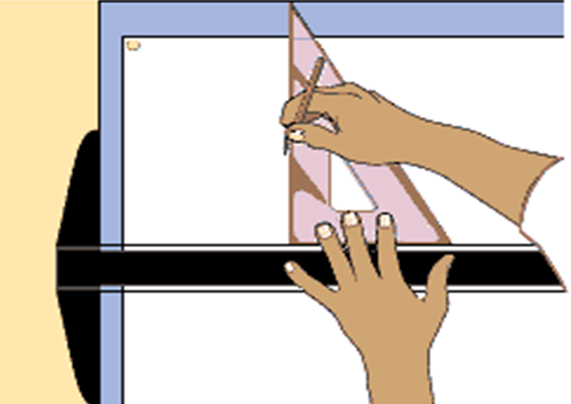
How to use T-square and Triangles
The T extension at the end of the T-square should always remain aligned with the side of the drawing table. This will cause it to remain horizontal.

Slide 18
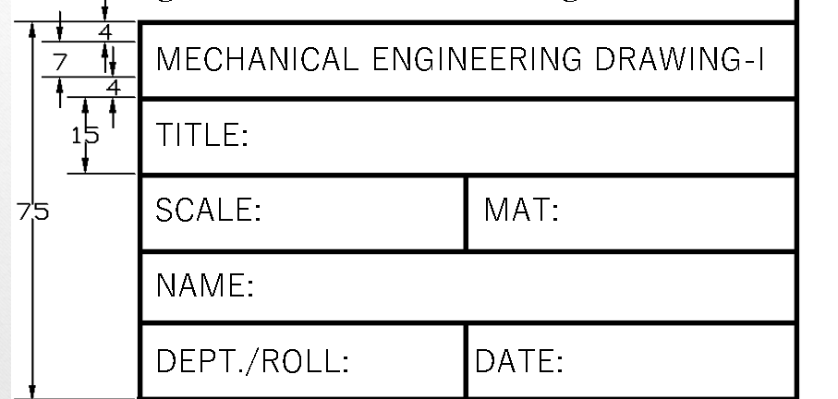

Daily Task
•Before the class starts:
Draw margins on your drawing sheet. Margins should be 10mm at all of four sides of the sheet.
At bottom right corner, sketch the following

Slide 19


THANK YOU

